Slide 1
RISHAB B
B.TECH ARTIFICIAL INTELLIGENCE AND DATA SCIENCE
PANIMALAR INSTITUTE OF TECHNOLOGY
Final Project
Contact:
LINKEDIN / GITHUB

Slide 2
ENHANCING IMAGE QUALITY WITH CONVOLUTIONAL AUTOENCODER APPROACH
PROJECT TITLE

Slide 3


AGENDA
Problem Statement
Project Overview
Who Are The End Users?
Your Solution and Its Value Proposition
The Wow In Your Solution
Modeling
Result
3/21/2024 Annual Review

Slide 4

PROBLEM STATEMENT
To generate more sharper and clearer images from blurry and unclear images using a Generative AI algorithm called autoencoder by utilizing the encoder-decoder architecture , implemented as a CNN (convolutional neural network) with a encoder network and decoder network.
INPUT IMAGES
Blurred
Fuzzy
Out of focus
Pixelated
Distorted
OUTPUT IMAGES
More defined
More detailed
More precise
High resolution
Detailed
AUTOENCODER

Slide 5

PROJECT OVERVIEW
By leveraging deep learning techniques, specifically convolutional neural networks (CNNs), the project seeks to transform blurry, low-resolution, or noisy images into sharper, clearer representations. Training the model on a dataset of degraded images, and evaluating its performance in enhancing image quality. Key components of the project include data collection and preprocessing, model design and training, evaluation metrics, and potential applications in various domains such as photography, medical imaging, surveillance, and digital media.
The project is built using various python libraries which includes
OpenCV
Keras
Numpy
Matplotlib

Slide 6

WHO ARE THE END USERS?
Photographers and Graphic Designers: Professionals in the field of photography and graphic design who require high-quality images for their work.
Medical Professionals: Doctors, radiologists, and medical researchers who rely on clear and precise images for diagnostic purposes and medical research.
Surveillance Operators: Operators and analysts in surveillance systems who need clear images for monitoring and analysis of security footage.
Researchers and Academia: Researchers in fields such as computer vision, image processing, and artificial intelligence who may use enhanced images for experimentation and academic purposes.
Manufacturing and Industrial Applications: Engineers and professionals in manufacturing and industrial sectors who require clear images for quality control, inspection, and process monitoring.
Artificial Intelligence and Technology Developers: Developers working on AI-based applications, algorithms, and systems that utilize image data as input or output.

Slide 7

YOUR SOLUTION AND ITS VALUE PROPOSITION
Dataset Composition:
Training dataset comprises approximately 800 normal images and blurred images . Blurred images are generated using Gaussian Blurring to simulate real-world distortion scenarios.
Training Process:
Utilizes a CNN architecture consisting of 2 layers of encoder and 2 layers of decoder. The encoder layers extract important features from input images, while the decoder layers reconstruct clearer representations.
Performance:
The achieved accuracy suggests the model can generalize well to new, unseen images beyond the training dataset.
From this solution the effectiveness of enhancing image quality using a CNN architecture can make the given image 80% more accurate.

Slide 8

THE WOW IN YOUR SOLUTION
Transformational Capability: The convolutional autoencoder has the remarkable ability to learn features from degraded images and reconstruct them into significantly improved versions with enhanced sharpness, clarity, and detail.
Automation and Efficiency: Reducing the need for manual intervention and tedious editing tasks. With just a few clicks, users can witness remarkable improvements in image quality, saving time and effort while achieving impressive results.
Versatility Across Domains: Application across various domains, including photography, medical imaging, surveillance, and digital media. Whether it's restoring old photographs, enhancing medical scans, or improving surveillance footage.
Real-Time Enhancement: In scenarios where real-time image enhancement is required, the convolutional autoencoder approach can deliver instant results, enabling immediate decision-making based on improved visual information
3/21/2024 Annual Review

Slide 9
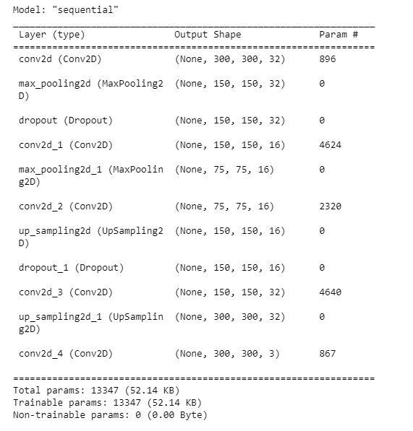
MODELING
Encoder Network:
Utilize convolutional layers followed by pooling operations to down sample the input images and extract hierarchical features.
Decoder Network:
Employ transposed convolutional layers or up sampling operations to up sample the feature maps and generate higher-resolution outputs.
Loss Function Selection:
To measure the discrepancy between the reconstructed images and the original input images during training.
Evaluation and Validation:
Evaluate the trained convolutional autoencoder on the validation set to assess its performance in enhancing image quality

Slide 10
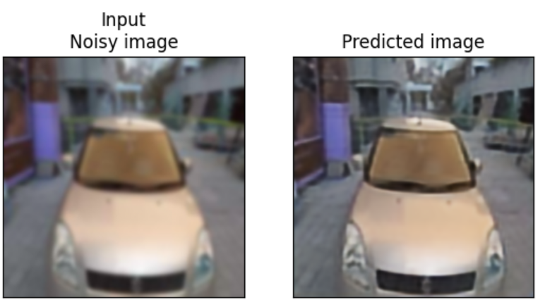
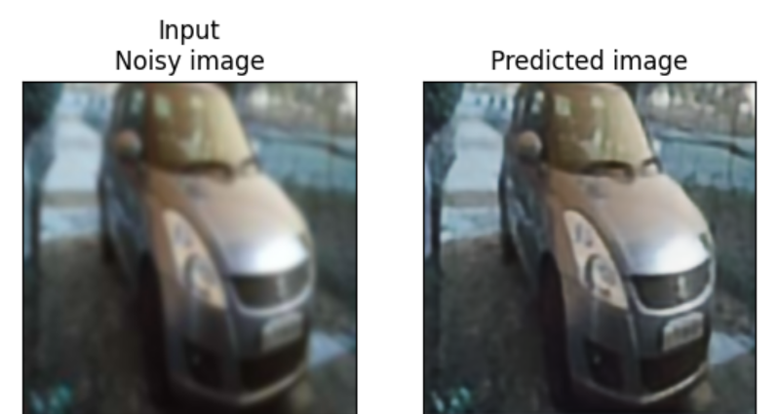
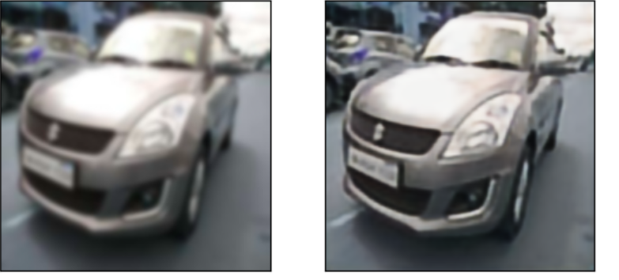
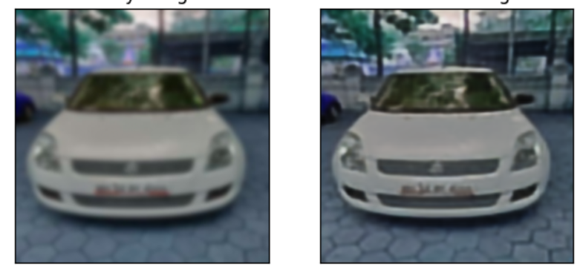
RESULTS
The results obtained from the convolutional autoencoder approach when given images of less quality generates more clearer images , some of the sample input and output images are shown below:
Project Link

